Slide 1

2024©
Connect 4 Game in Python
LASNIER - LAZREG – POILVE
Applied System Software

Slide 2

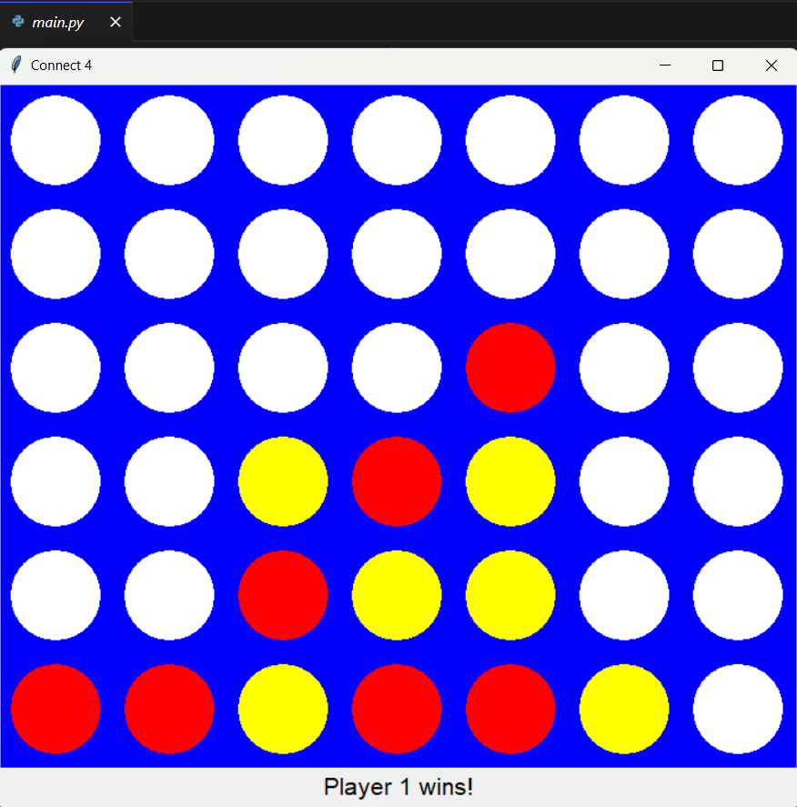
Presentation of Project
Connect 4 video game coded in python with a simple interface, accompanied by instructions for using the computer program.
For simplicity purposes we chose to use a basic library (Tkinter)

Slide 3
Agenda
1. Report 2.GitHub 3.Presentation
Software Requirements
Black-Box Testing/Test Cases
Design
Software Design
Implementation
Testing

Slide 4
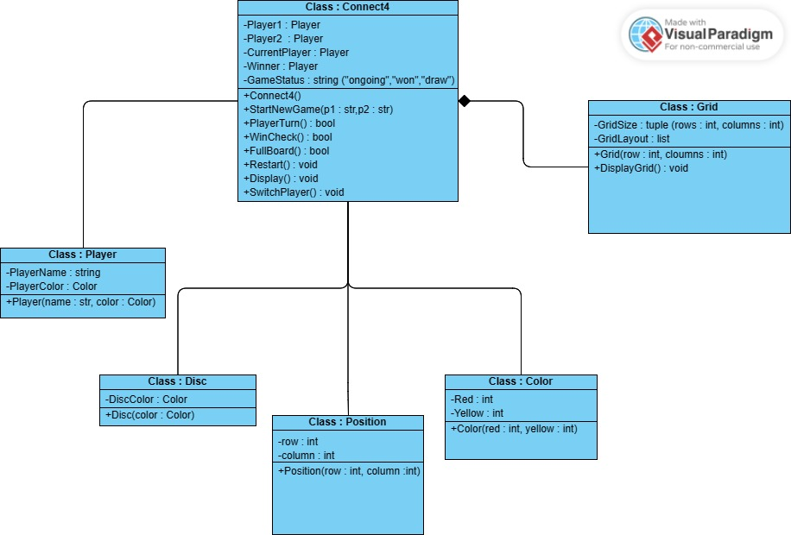
Software Design
UML class diagram
Class
Connect4
Player
Grid
Disc
Position
Color

Slide 5
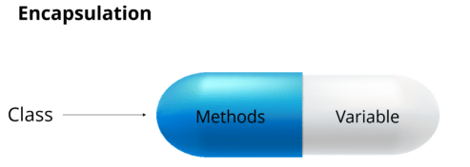


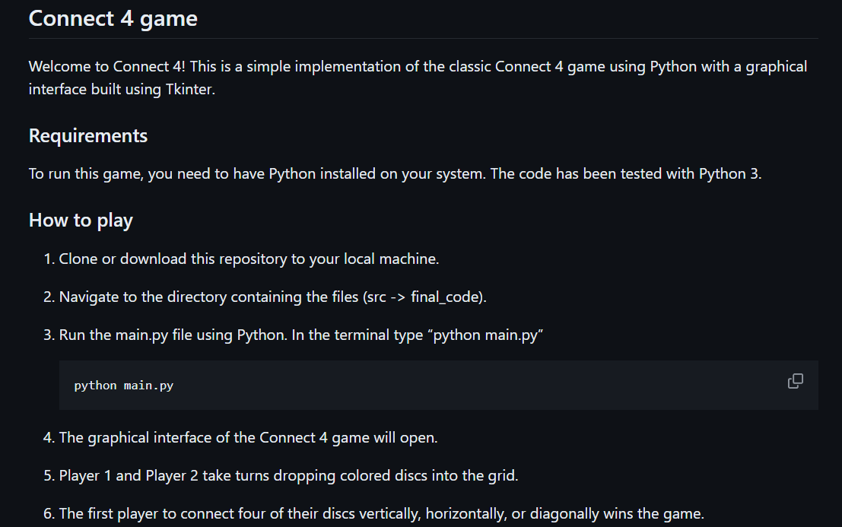
Implementation
Programming concepts used :
user input/output
Object Oriented Programming
Conditional statements
Composition (to represent relationship between our classes)
Event handling (to spawn a coin when the player clicks)
Encapsulation
+ Documentation (ReadMe)

Slide 6
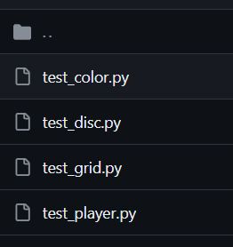

Tests of the game
4 files

Slide 7
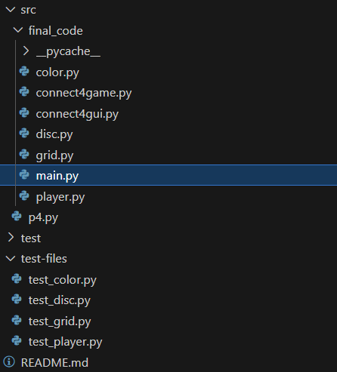
Demo of Alpha and Release version
Code Tree

Slide 8
Repartition (7 à 10min)
Mehdi :
Aurélien :
Alexandre :

